Slide 1
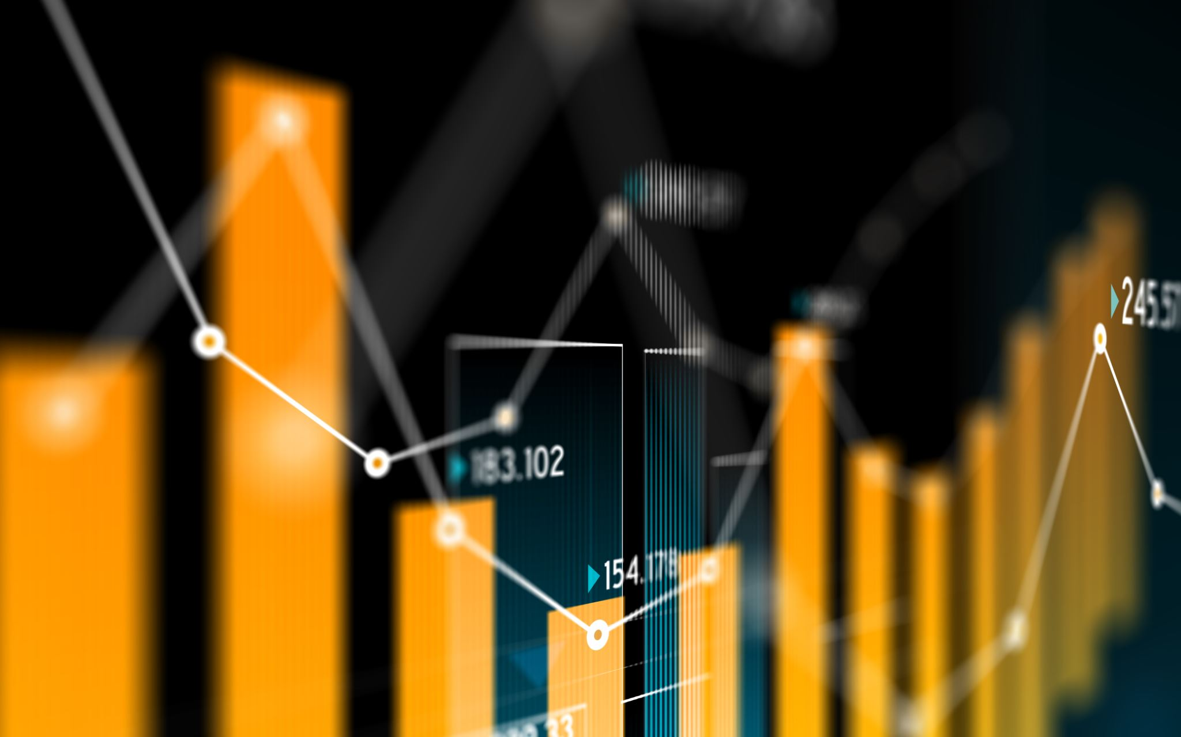
Homework 6 (PPT with figures) BIOL792 Biological Datasets

Slide 2
Figure that I don’t like
Busta et.al, 2018

Slide 3
Better Version of Figure Above

Slide 4
One I like
Busta et.al, 2018

Slide 5
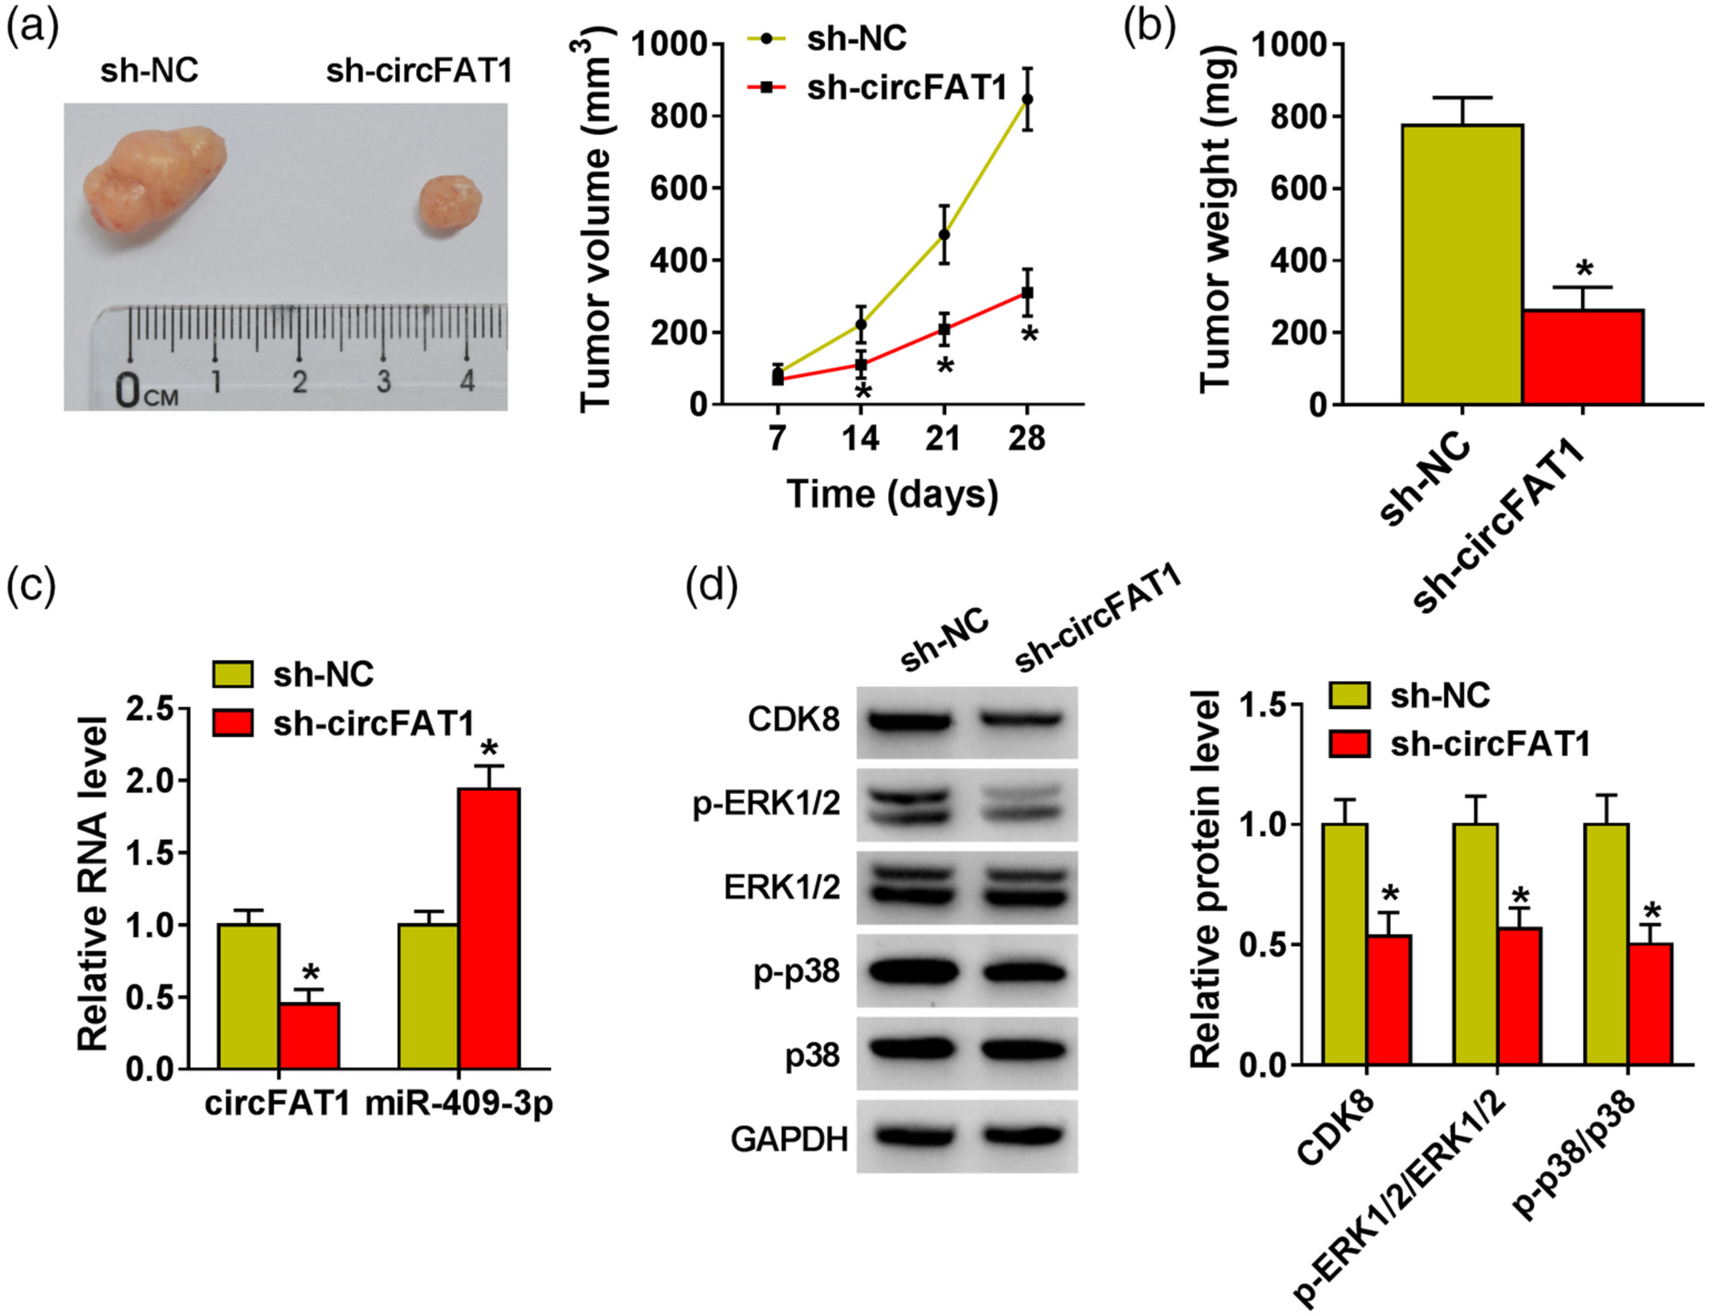
One I like
Zhou et.al, 2021

Slide 6
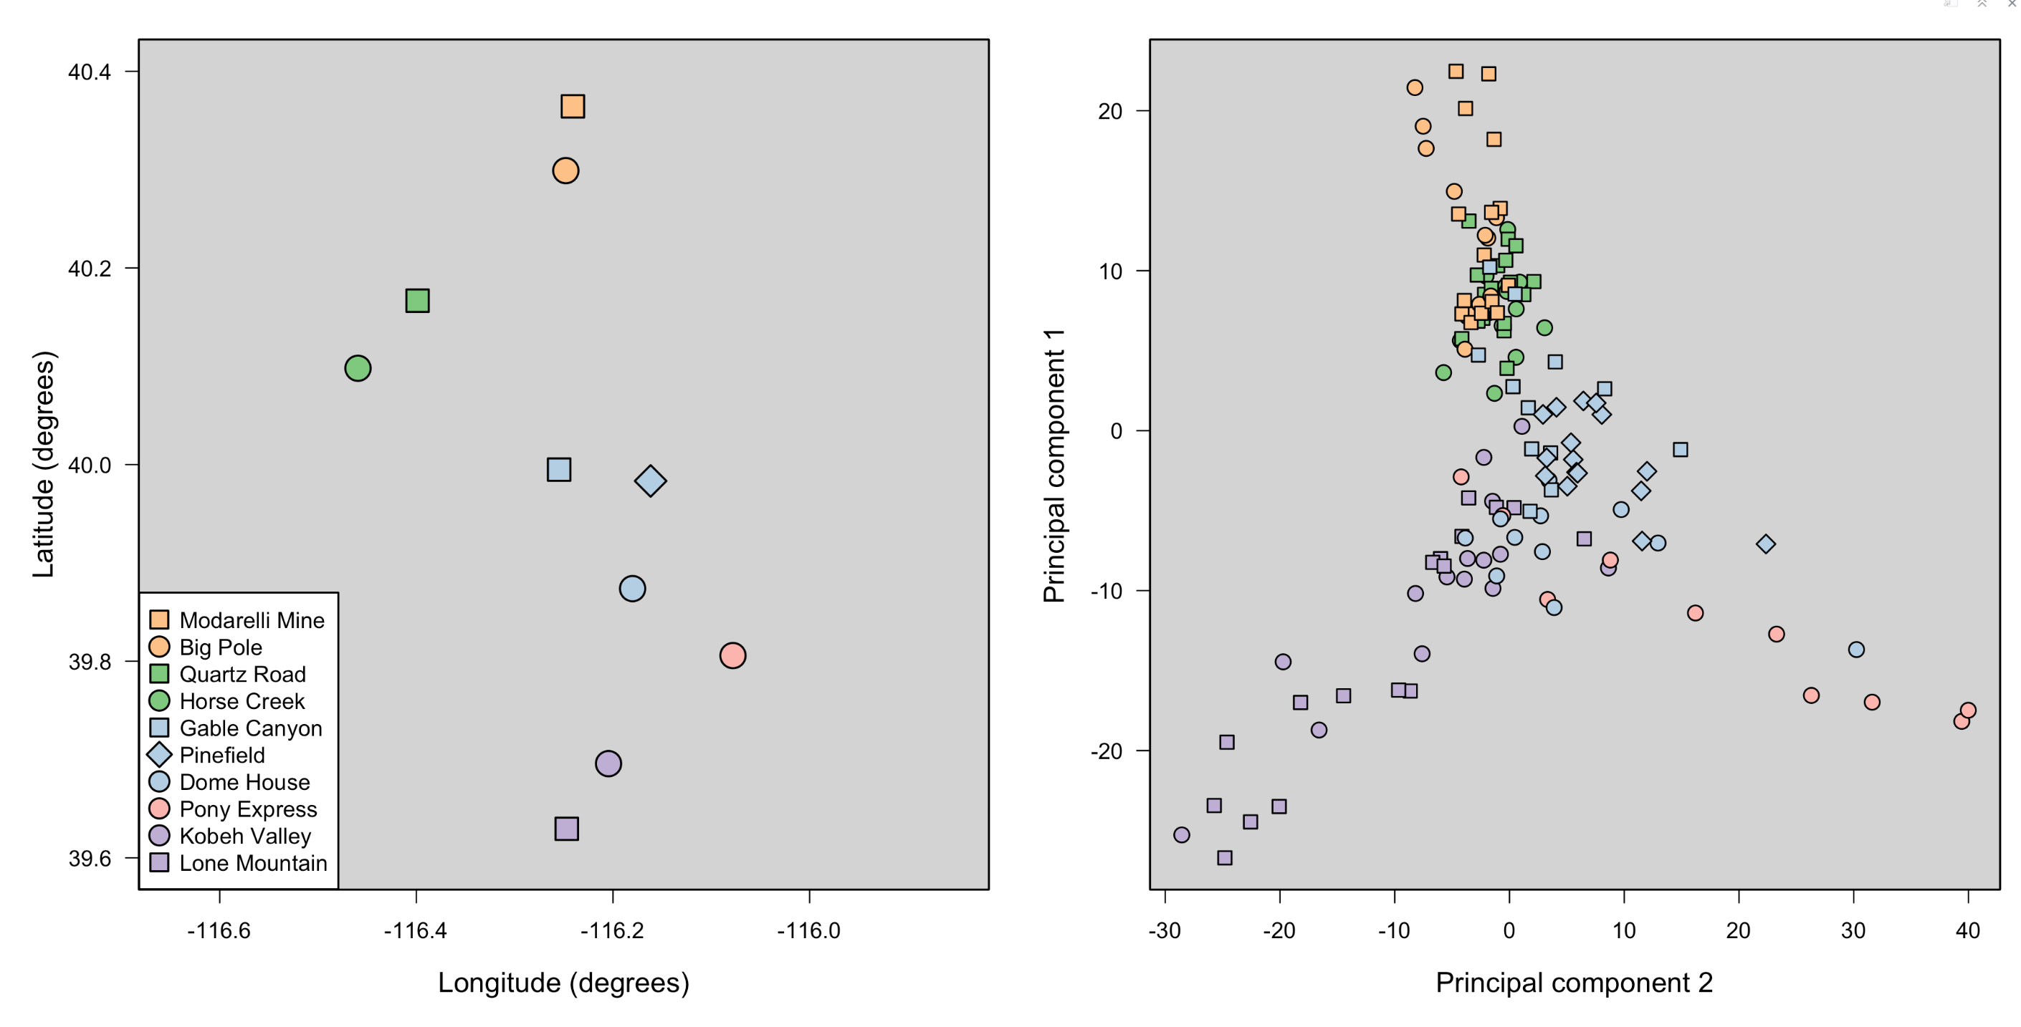
Remake of Figure 2.5 (using the fun color palette that I like)

Slide 7
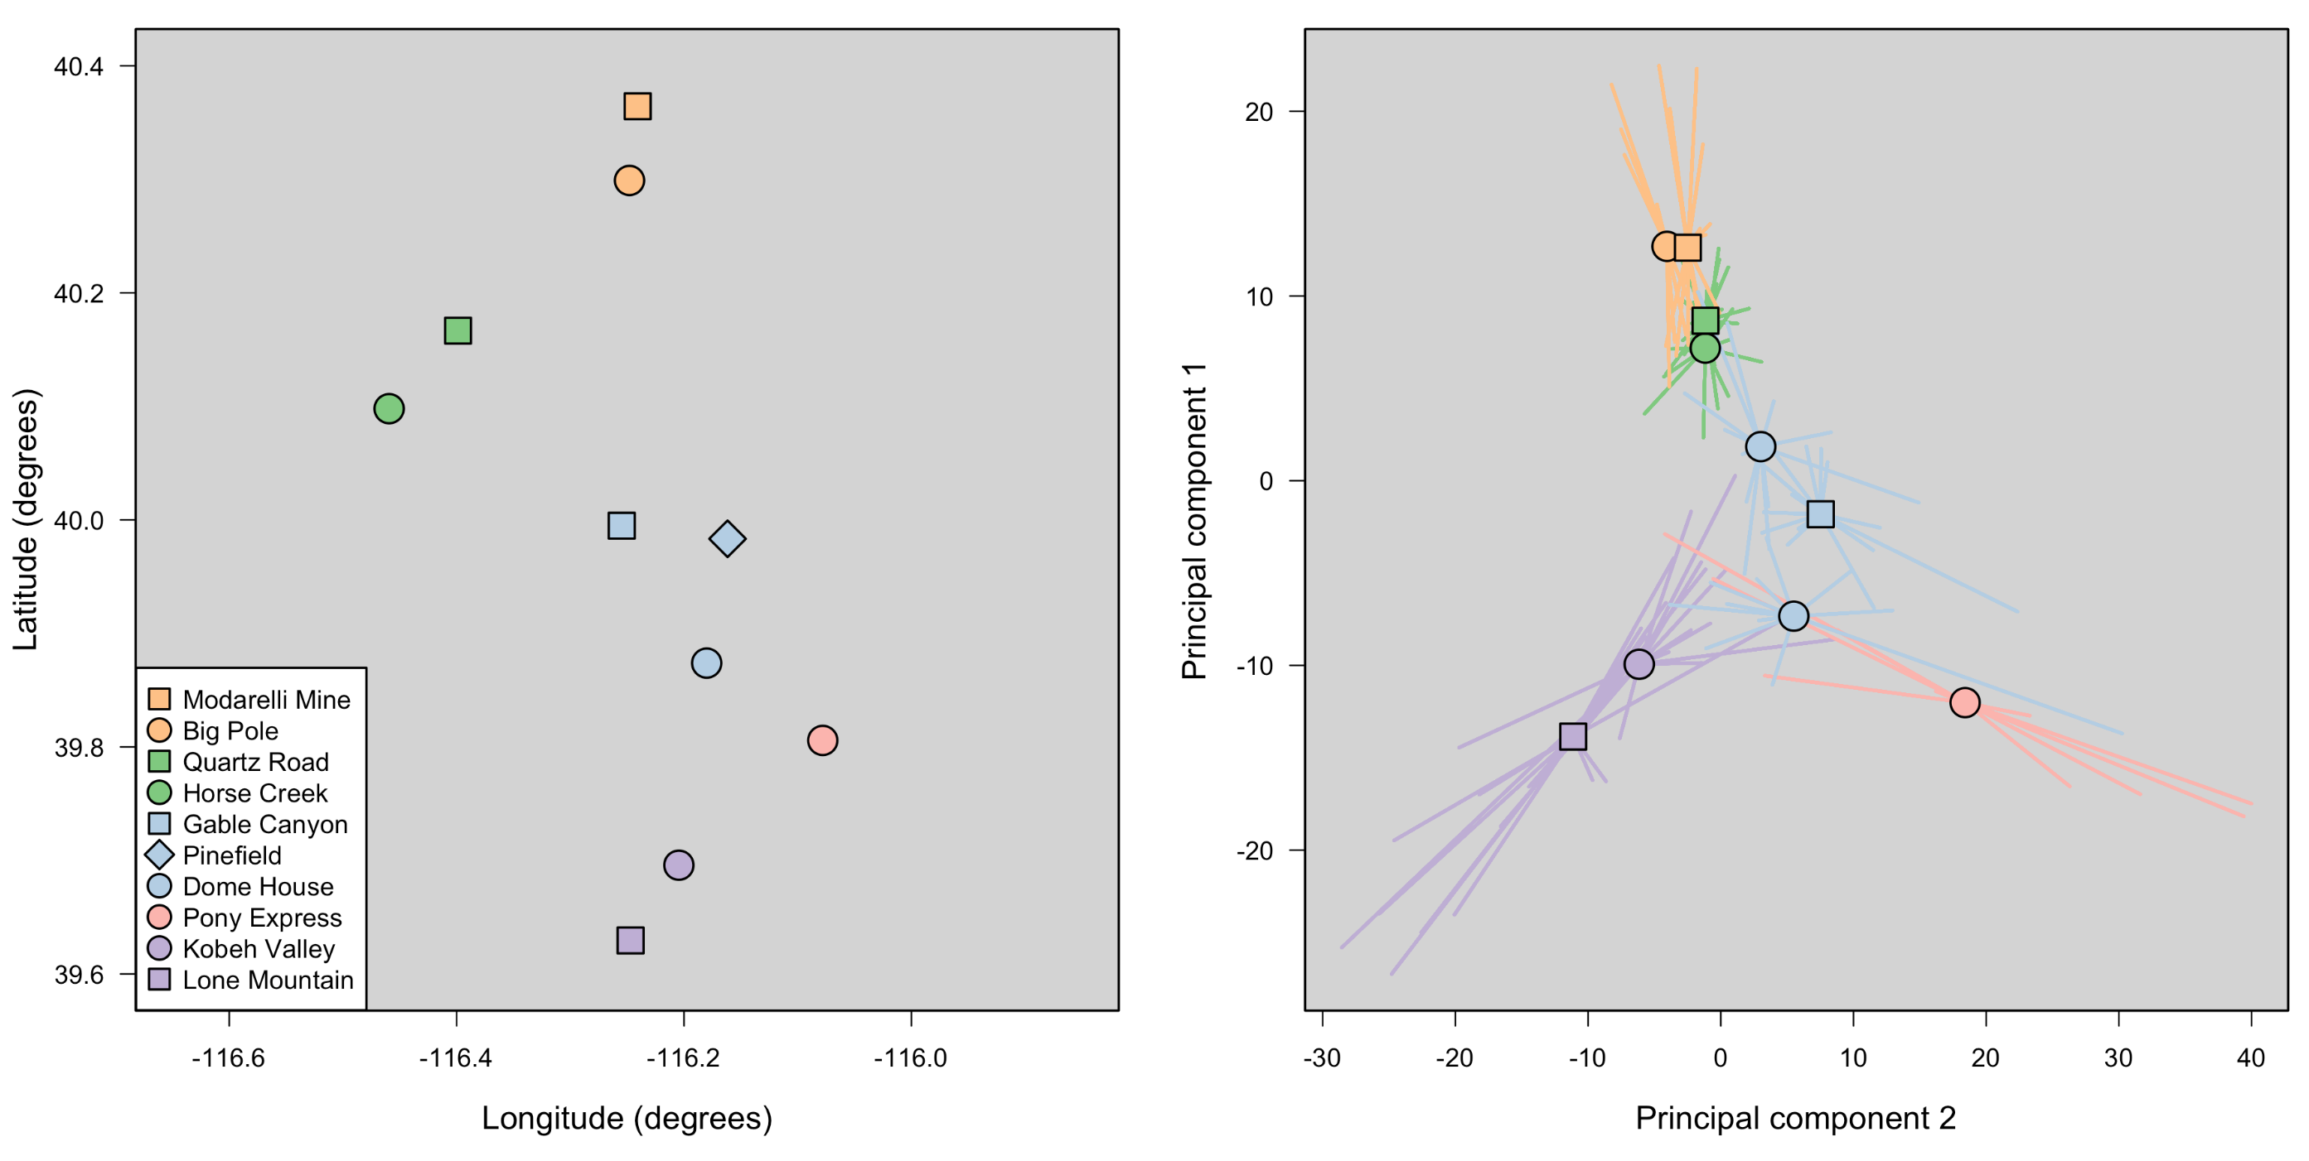
Remake of Figure 3.1 (using the fun color palette that I like)

Slide 8
Thank You! ☺

